Slide 1
Real Estate - Property Price Prediction

Slide 2
Contents:
Business Problem
Data Summary
Assumptions & Considerations
Approach

Slide 3
Business Problem
Our client is a Real Estate aggregator company that lists properties across the country in their platform. Property owners can enlist their properties in the platform and the customers can directly contact the owners if they like to enquire about a property.
The customers found that similar properties in the same area have a huge difference in their prices. They have contacted the support team and raised the issue multiple times.
This inconsistency in pricing is creating a lack of trust on the platform and hence the company called us to build a price discovery and regulation model that would estimate the price range of a property given its attributes like area, apartment type, amenities, etc.

Slide 4
Data Summary (link)
Total No. of Records | 200
Total No. of Columns | 17
Data availability | Pune, Maharashtra, India
Assumptions & Considerations:
Only Pune data is considered here for this project (the flow would still be the same even for multiple/all of the cities if it is present)
Price of a new listed apartment could be predicted based on the amenities and other features basis the past historical data.

Slide 5
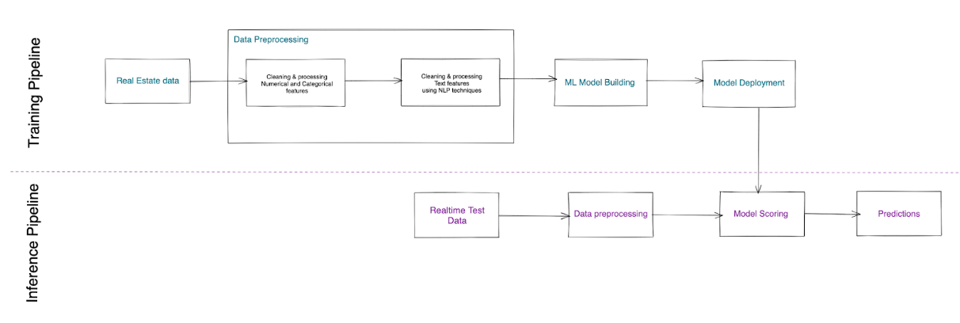
Approach

Slide 6
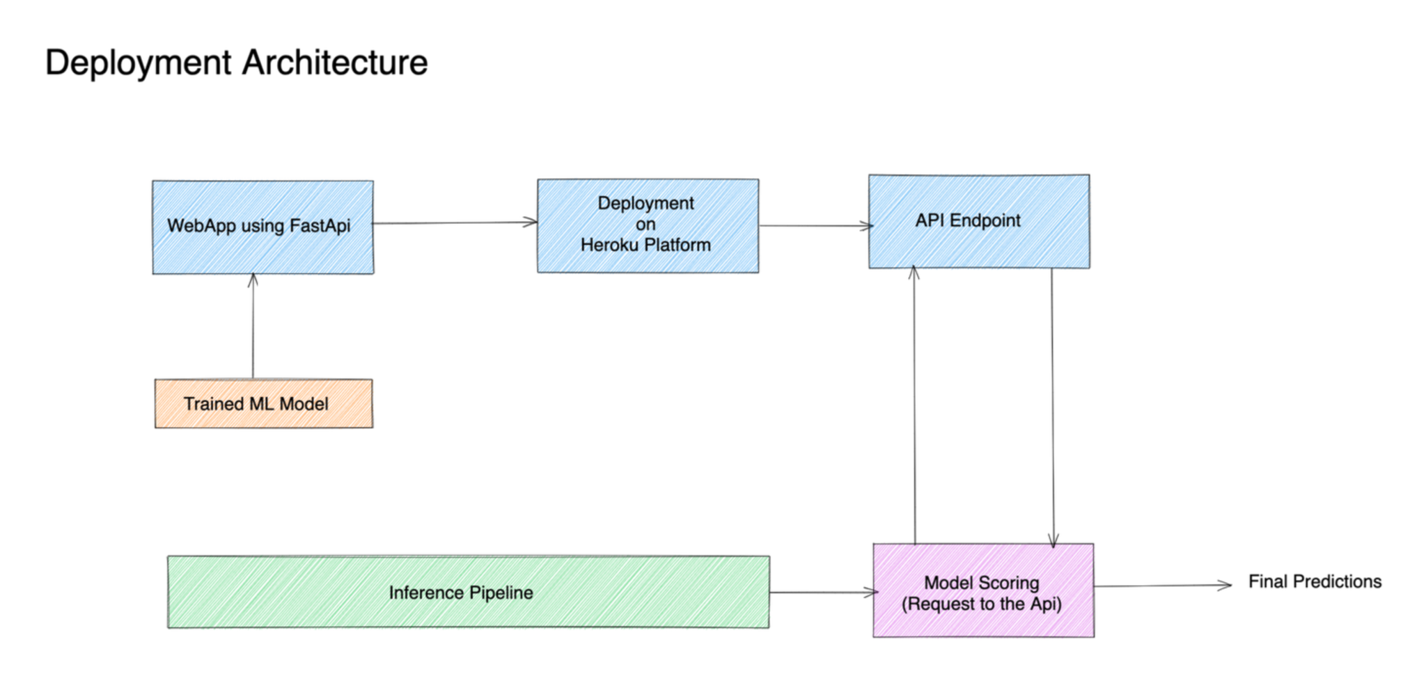
Approach (Contd..)

